Slide 1
RNN Networks
12/02/18

Slide 2
Contents
Introduction
Applications of RNN
Types of RNN cells
Types of RNN layers
Examples on RNN networks
References

Slide 3
Introduction
Recurrent Neural Networks (RNNs) are popular models that have shown great promise in many NLP tasks.
The main idea behind RNNs is to make use of sequential information.
In theory RNNs can make use of information in arbitrarily long sequences, but in practice they are limited to looking back only a few steps.

Slide 4
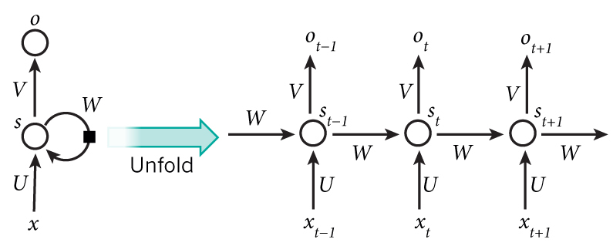
RNN network
x_t is the input at time step t.
s_t is the hidden state at time step t.
o_t is the output at step t.

Slide 5
Applications
Language Modeling and Generating Text
Machine Translation
Speech Recognition
Generating Image Descriptions

Slide 6
Types of RNN Cells
BasicLSTMCell
BasicRNNCell
GRUCell
LSTMCell
MultiRNNCell

Slide 7
API for RNN Cells
RNN Cell | API
BasicLSTMCell | tf.nn.rnn_cell.BasicLSTMCell(num_units)
BasicRNNCell | tf.nn.rnn_cell.BasicRNNCell(num_units)
GRUCell | tf.nn.rnn_cell.GRUCell(num_units)
LSTMCell | tf.nn.rnn_cell.LSTMCell(num_units)
MultiRNNCell | tf.nn.rnn_cell.MultiRNNCell(cells)

Slide 8
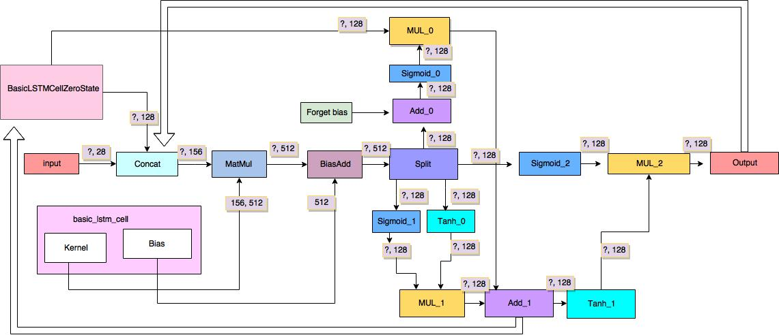
BasicLSTMCell

Slide 9
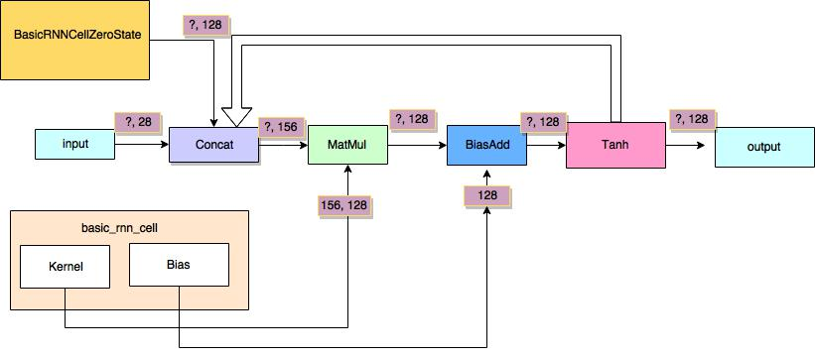
BasicRNNCell

Slide 10
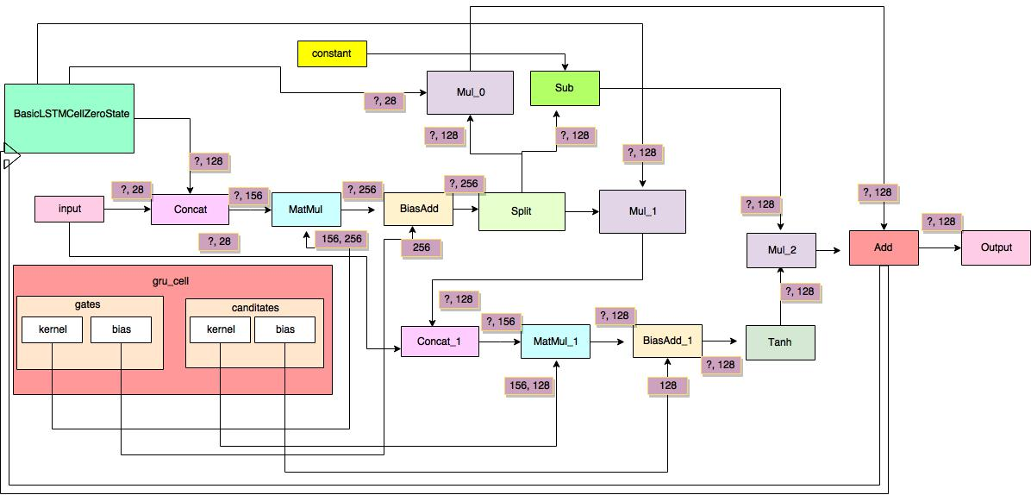
GRUCell

Slide 11
LSTM vs GRU
GRUs train faster and perform better than LSTMs on less training data if you are doing language modeling.
GRUs are simpler and thus easier to modify, for example adding new gates in case of additional input to the network. It's just less code in general.
LSTMs should in theory remember longer sequences than GRUs and outperform them in tasks requiring modeling long-distance relations.

Slide 12
Types of RNN Layers
StaticRNN
DynamicRNN
Static BidirectionalRNN
Dynamic BidirectionalRNN

Slide 13
API for RNN Layers
RNN Layer | API
StaticRNN | tf.nn.static_rnn(inputs=layer, cell=multi_cell, dtype=tf.float32)
DynamicRNN | tf.nn.dynamic_rnn(inputs=layer, cell=lstm_cell, dtype=tf.float32)
Static BidirectionalRNN | tf.nn.static_bidirectional_rnn(inputs=layer, cell_fw=lstm_cell, cell_bw=rnn_cell, dtype=tf.float32)
Dynamic BidirectionalRNN | tf.nn.bidirectional_dynamic_rnn(inputs=layer, cell_fw=lstm_cell, cell_bw=rnn_cell,dtype=tf.float32)

Slide 14
Bidirectional RNN’s
The principle of BRNN is to split the neurons of a regular RNN into two directions, one for positive time direction (forward states), and another for negative time direction (backward states).
The basic idea of BRNNs is to connect two hidden layers of opposite directions to the same output.

Slide 15
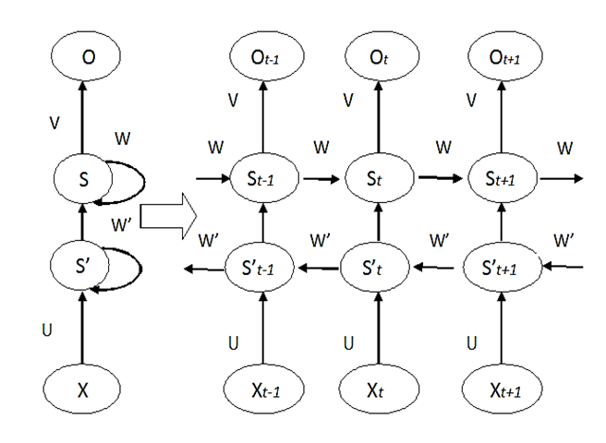
Bidirectional RNN’s

Slide 16
Char RNN Tensorflow
Git Link : Char RNN Tensorflow

Slide 17
References
Introduction to RNNs
Understanding LSTMs
Empirical Evaluation of Gated Recurrent Neural Networks on Sequence Modeling
GRU vs LSTM
Bidirectional RNNs
RNN samples

Slide 18
Thank You

